Slide 1

Fraud Detection SAS ETL Pipeline
DEMO

Slide 2




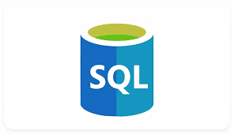
WorkFlow
Data Extraction: Download, store, and version-control data in GitHub.
Data Processing: Clean, transform, and enrich transaction data
Reporting: Generating Dimensional Table Reports.
Modeling: Machine Learning for Fraud Detection.
Visualization: Creating Plots for Business Insights.

Slide 3
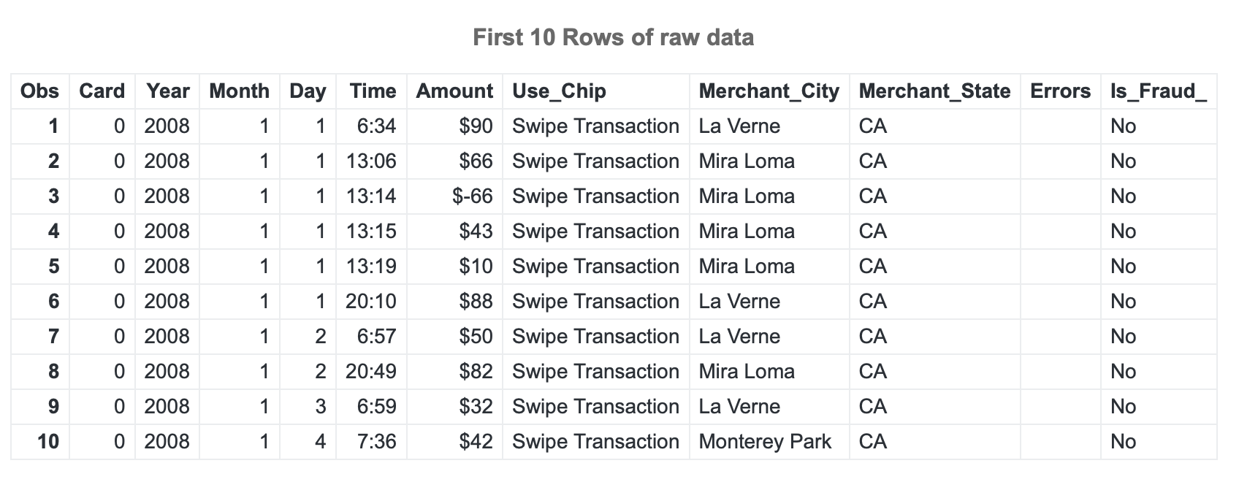
DATA
The dataset presents an extensive collection of around 24.4 million credit card transactions, sourced from IBM's financial database. Capturing a wide spectrum of user interactions, the data provides a detailed snapshot of transaction behaviors, patterns, and potential vulnerabilities.
Details include: User & card info, time & Amount of transactions, merchant details, fraud detection flag.
Sampling: A subset of the whole dataset contains 1164 rows and 15 variables.
Source: https://www.kaggle.com/datasets/ealtman2019/credit-card-transactions/data?select=sd254_users.csv

Slide 4

1. Data Processing

Slide 5
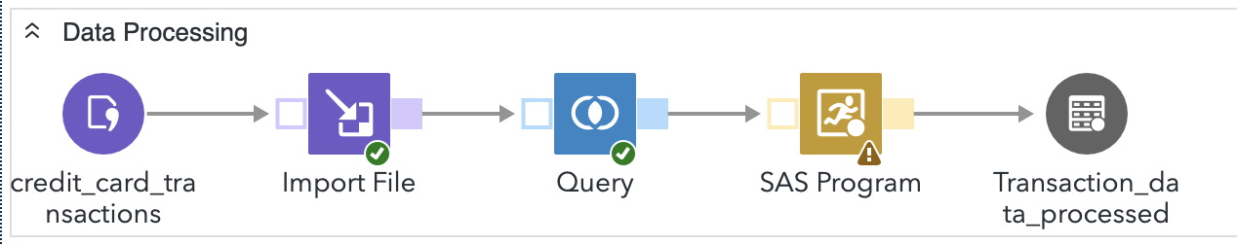
1. Data Processing
1. Import
Source: credit_card_transactions dataset.
Raw data is imported using the Import File step.
2. Selection & Filtering (Query)
The dataset is filtered to include only transactions where 'Year' is 2008, 2015, or 2016.
Ensures relevant column is selected before further transformations.
3. Data Transformation (SAS Program)
Handling Missing Values (PROC SQL Update Step):
Merchant_State is set to "Unknown" if missing.
Errors column is also defaulted to "Unknown" if empty.
Categorization Based on Merchant_State:
Transactions are classified into group based on Merchant_State:
US State → If Merchant_State belongs to a list of 50 U.S. states.
Other → All other cases.

Slide 6
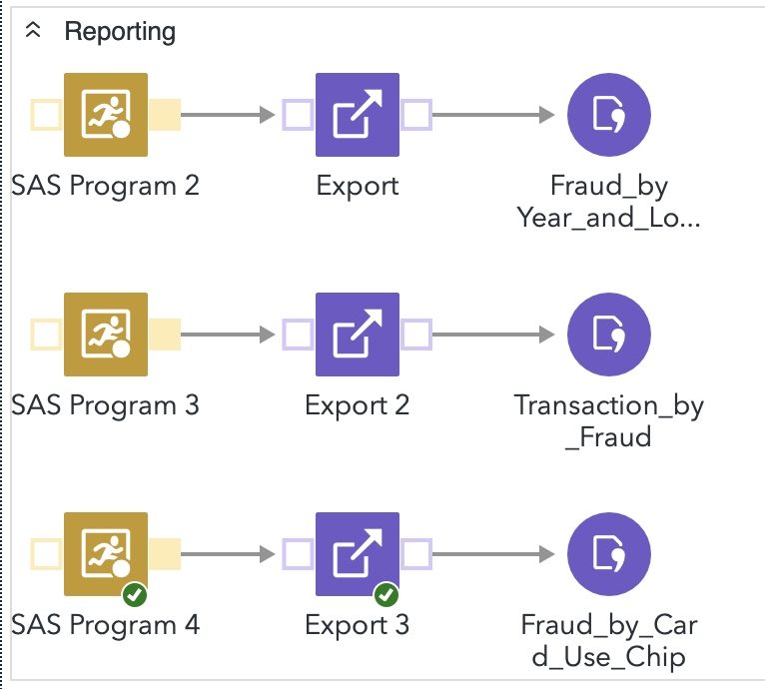
2. Reporting
Generate Dimensional Table

Slide 7
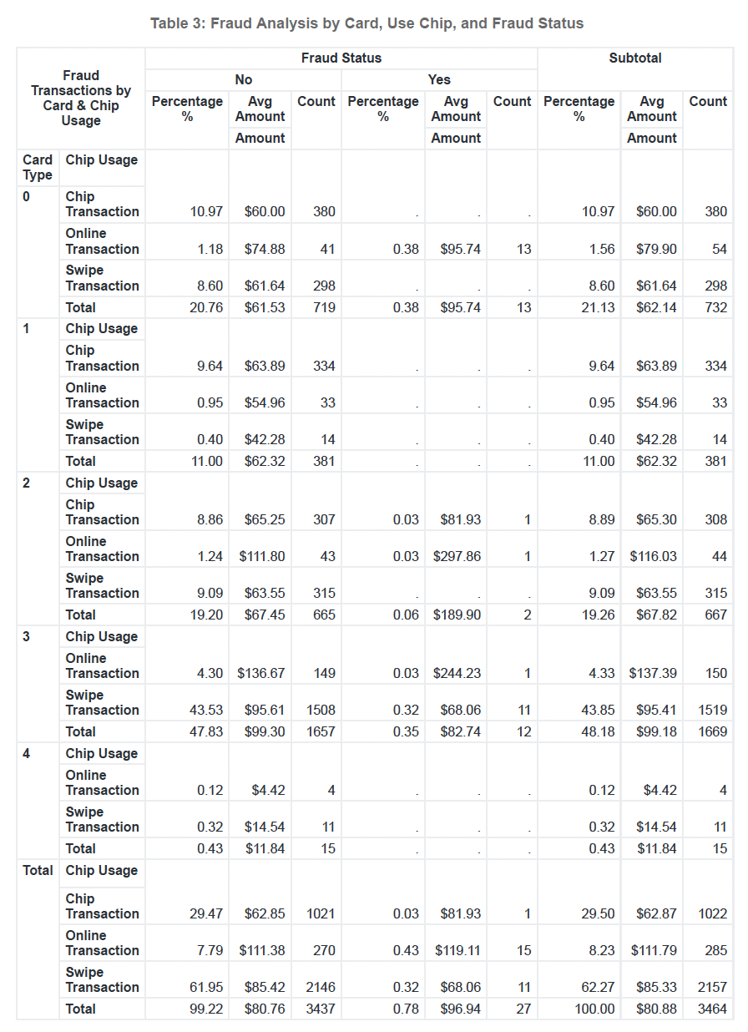
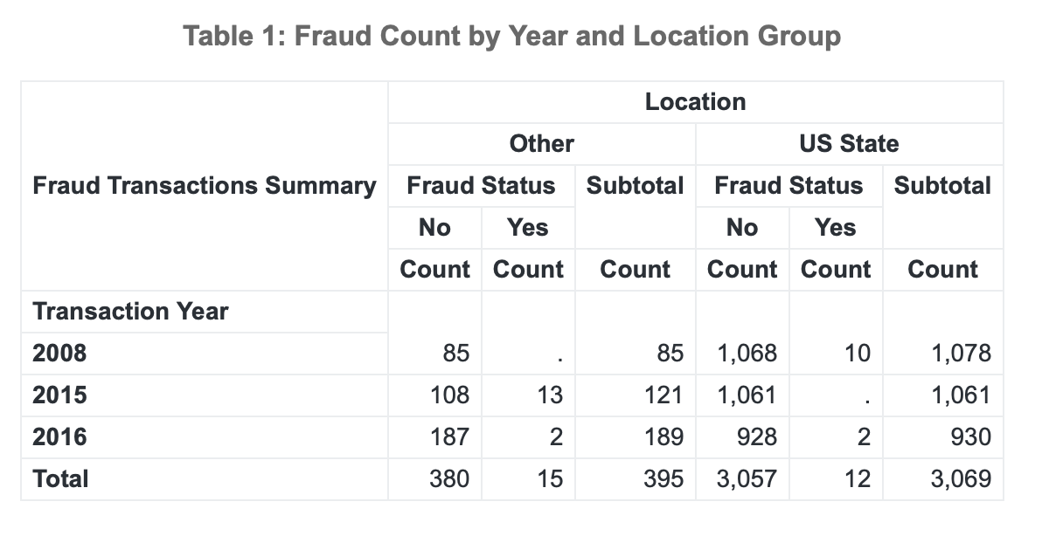
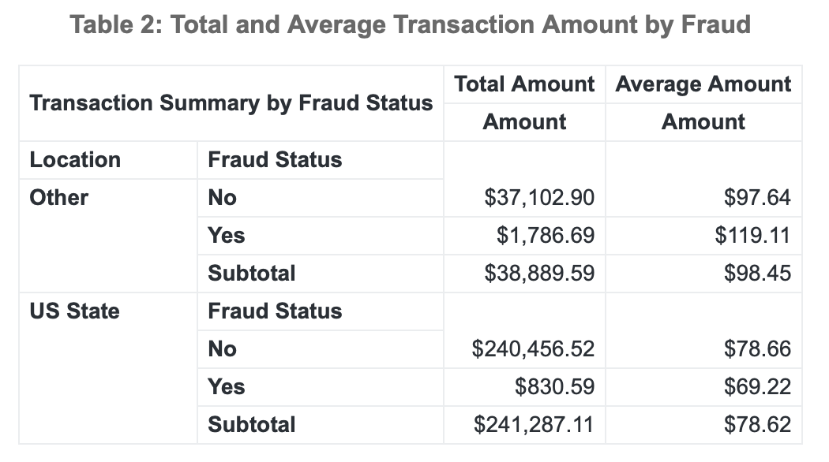
2. Reporting
Key Insights
Table 1: 2016 had the lowest fraud count (4 cases in total) compared to 2015 (13 cases) and 2008 (10 cases) in the US States.
Table 2: Fraudulent transactions have lower average amounts than non-fraudulent ones in US.
Table 3: Online transactions have a higher fraud percentage than chip-based transactions.

Slide 8
3. Modeling
Machine Learning Model for Fraud Detection

Slide 9
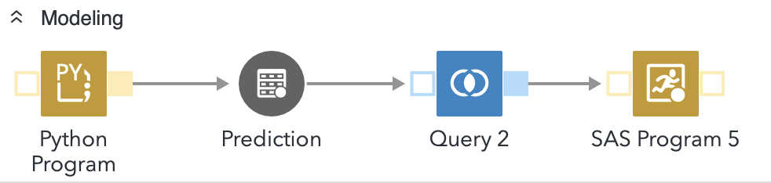
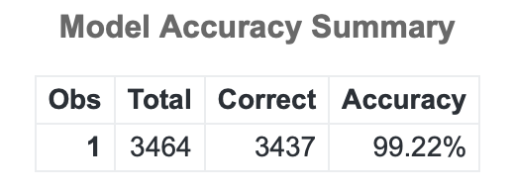
3. Modeling
Python Program
1. Prepares data for machine learning:
Encoding Card as numeric using LabelEncoder.
Selecting Amount, Card, and Year as features (X).
2. Splits data into training (70%) and testing (30%) sets.
3. Trains a Random Forest Classifier on the training data.
4. Evaluates model performance using a classification report and accuracy score.
5. Predicts fraud status for the entire dataset.
Query & SAS Program
1. Creates accuracy_table to store model accuracy results.
2. Calculates total records and correct predictions.
3. Computes accuracy.

Slide 10
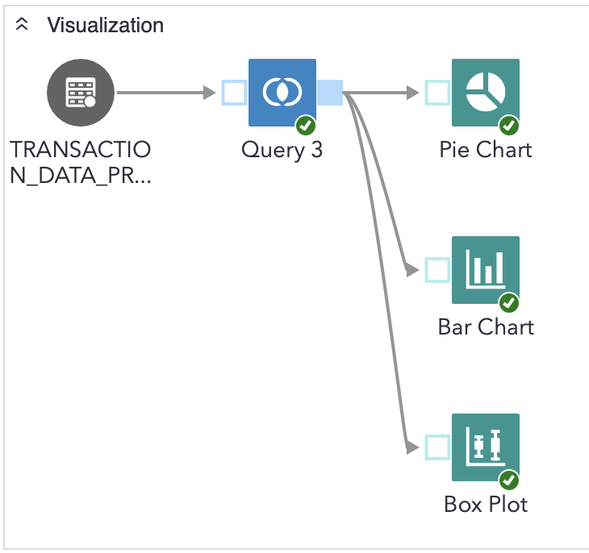
4. Visualization

Slide 11
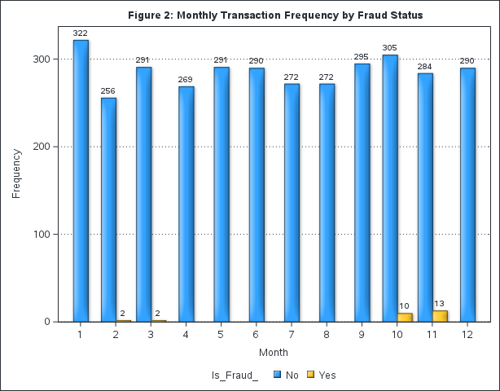
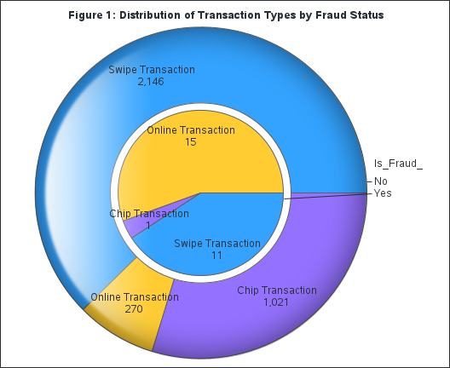
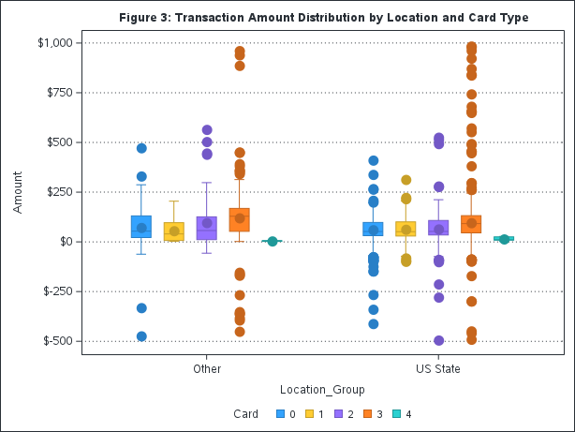
4. Visualization
Key Insight
Figure 1: Online Transactions account for the majority of transactions in fraud cases.
Figure 2: Fraud cases occur sporadically, with spikes in October and December.
Figure 3: Card Type 3 (orange) consistently has the highest transaction amounts, which may indicate higher spending patterns or risk exposure.

Slide 12
Future Improvements & Takeaways
Automate Data Ingestion & Processing
Integrate scheduled data pipelines to automate import, processing, and reporting.
Enhance Data Quality & Validation
Implement data validation checks (e.g., missing values, inconsistencies) before processing.
Introduce logging & alerting for anomalies in transaction data.
Optimize Model Deployment & Predictions
Use real-time streaming predictions (Kafka or AWS Lambda) for fraud detection.
Expand Reporting & Visualization
Add interactive dashboards (Power BI, Tableau) for dynamic fraud trend analysis.
✅ Structured Workflow: Clear segmentation of data processing, reporting, modeling, and visualization.
✅ Efficient Fraud Analysis: Machine learning integration helps detect fraud effectively.
✅ Comprehensive Reporting: Generates fraud insights across different dimensions.
✅ Visualization for Decision-Making: Pie, bar, and box plots highlight transaction trends and risks.

Slide 13
THANK YOU
Hongyi Zhan
4373336135
Hongyi.zhan@mail.mcgill.ca
https://www.linkedin.com/in/hongyi-zhan/

